Slide 1
Air Quality & Wood Energy in the Fairbanks North Star Borough
Nick Czarnecki
FNSB Air Quality Manager
Presentation for the Department of Natural Resources
August 8, 2018

Slide 2
Presentation Overview
Background
Regulatory structure
Borough’s Primary Role
Current Status
SIP Process
Importance of dry wood
Open burning
Possibilities for coordination

Slide 4
Background
Serious Designation in 2017 = More stringent regulations for all contributing sources
Source Sector:
Point Sources
Area Sources, Space Heating (i.e. wood, oil, coal, other)
Area Sources, Other
On-Road Mobile Sources
Non-Road Mobile Sources

Slide 5
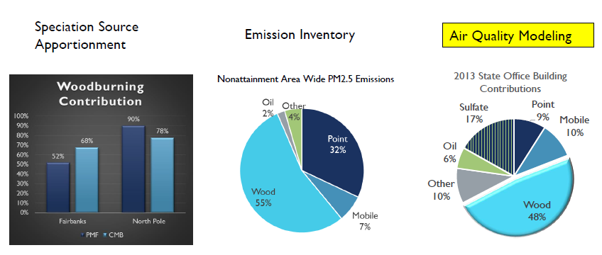

Slide 6
Regulatory Structure -
Clean Air Act (CAA) - comprehensive federal law that sets national standards for certain widespread air pollutants in order to address public health and welfare risks.
U.S. Environmental Protection Agency (EPA) - primary regulatory authority
Like most federal statutes, the CAA is primarily implemented by states, local and tribal authorities, which have been delegated implementing and regulatory authority by EPA.
EPA has delegated regulatory authority to the Alaska Department of Environmental Conservation (ADEC).
Local control of area sources has been delegated to the Borough through a Memorandum of Understanding (MOU) with ADEC.

Slide 7
Regulatory Structure -
Clean Air Act (CAA)
Enforced by
Environmental Protection Agency (EPA)
Delegates Implementation and Regulatory Authority to
States, Local & Tribal Authorities
Specifically – EPA delegated regulatory authority to ADEC, who delegated control of local area sources to the Borough through a Memorandum of Understanding (MOU) with ADEC.

Slide 8
Borough’s Primary Role
Act as primary regulatory authority for area sources including (not limited to): solid fuel-fired heating devices, commercial and residential space heating, and small sources that fall below permitting thresholds.
Implement PM_{2.5} control strategies to attain the standard that are shown to be feasible & cost effective.

Slide 9
Borough’s Primary Role
Borough’s Air Quality Division primary responsibilities include:
Education and outreach
Wood Stove Change Out Program
Special purpose monitoring
Borough code compliance (curtailment)
Complaint investigation

Slide 10
Current Status
Borough working on:
Primary responsibilities
Stakeholders Group http://fnsb.us/transportation/Pages/stakeholders.aspx

Slide 11
Current Status
ADEC working on Serious SIP dec.alaska.gov/air/anpms/communities/fbks-particulate-matter/

Slide 12
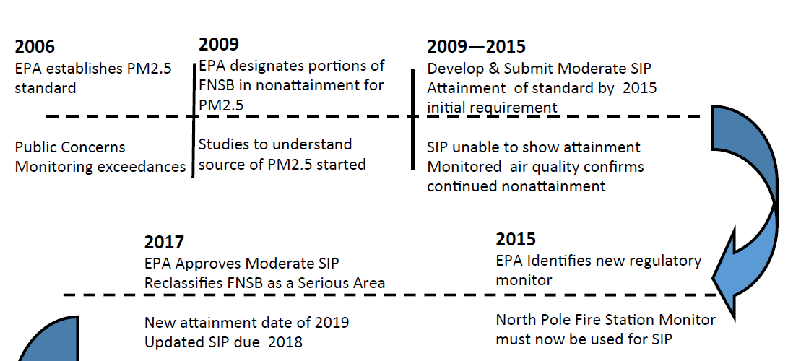
SIP Process Chart

Slide 13
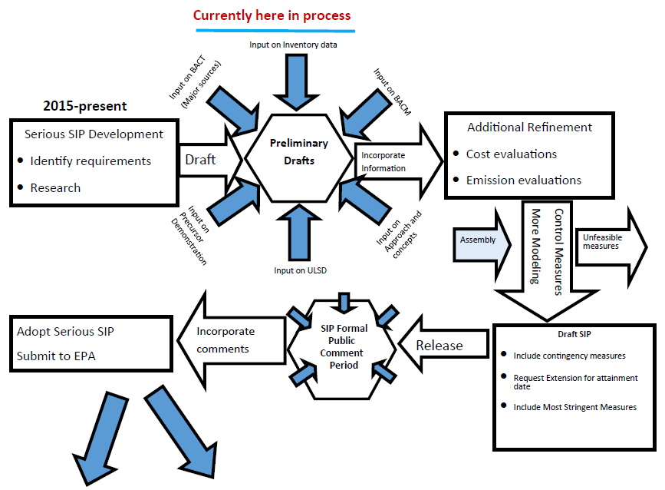
Meet Commitments / Attainment
Failure to meet Commitments / Attainment
Notes:
Meet Commitments/Attainment
• Implement strategies
• Achieve compliance
• Meet health based standards
OR
Failure to meet commitments or meet attainment:
• Implement Contingency measures
• More control measures
• Potential Sanctions

Slide 14
Importance of Dry Wood
Emissions from wood devices dependent on: device, fuel, & operation
FNSB & ADEC requirement of clean dry wood of <20% moisture content
Wood storage requirement for WSCOP, Stage 1 waiver, NOASH
Training requirement on wood burning appliances and importance of dry wood

Slide 15
State ADEC Requirements
ADEC requirements of dry wood & registration of commercial wood sellers
https://dec.alaska.gov/air/burnwise/wood-seller/

Slide 16
Potential SIP Requirements
Potential control measures affecting dry wood under consideration for Serious SIP:
Dry wood only sales by commercial wood sellers
Development of a Regional Kiln or Wood Drying facility
Require all homes to have wood storage
Require dry wood to be clearly labeled
Distribution of information related to moisture content at time of sale of wood

Slide 17
Open Burning
Two basic concerns with open burning
that it does not spread and become a wildfire (DNR)
that it does not cause air pollution that creates a health hazard or a public nuisance (ADEC)
Borough
Prohibited during AQ alerts
Subject to PM2.5 crossing property lines & opacity limits

Slide 18
Possibilities for Coordination
Help promote importance of burning dry wood
Cutting wood in spring/early summer to provide sufficient time to dry, preferably cutting a year early.
Include required training on how to know if the wood is dry as part of getting permit (e.g. moisture meters)
Sharing data for planning purposes
Number of permits issued
Number of permits for harvesting 20+ cords/season

Slide 19
Possibilities for Coordination
Coordinated Education and outreach
Open burning
Woodcutting Event

Slide 20
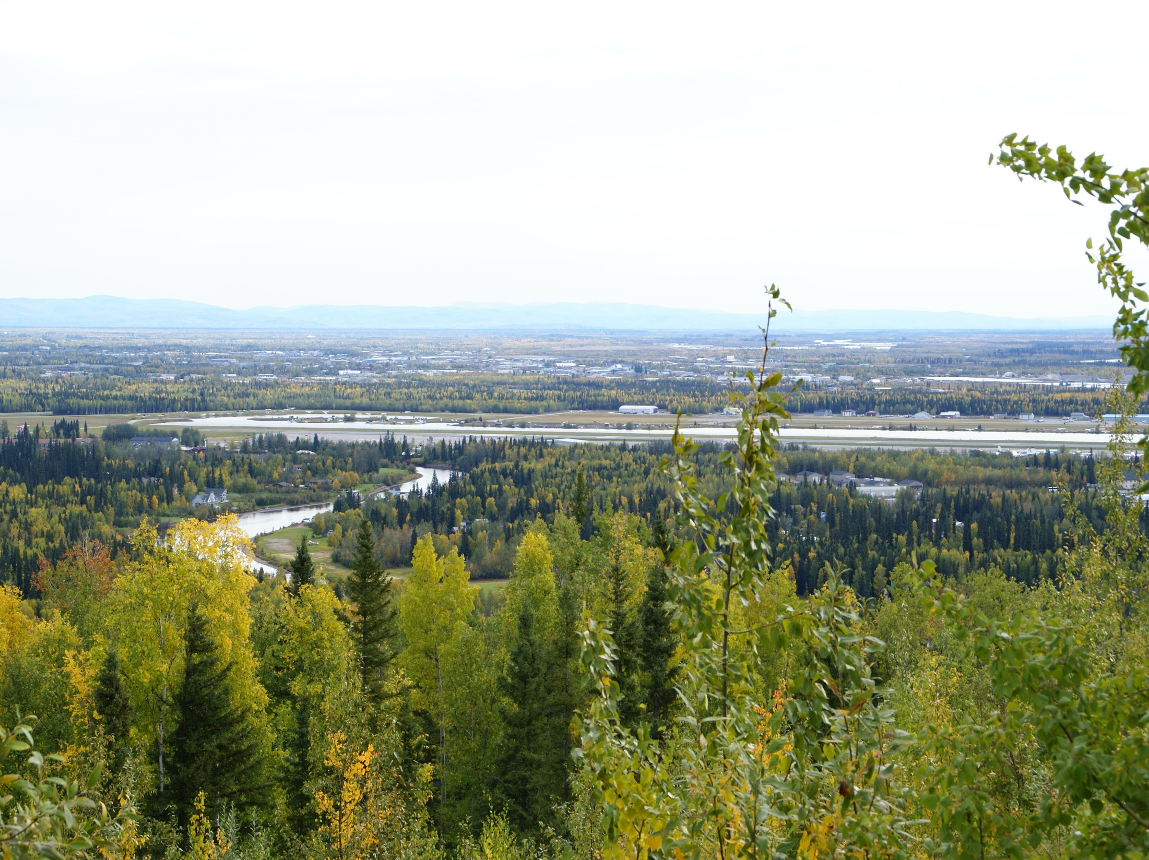
Visit AQFairbanks.com Today! Questions?

